Slide 1

Mining Tweets for Sentimental analysis and Comparing with Stock Movement
MILESTONE-1
~G.SUKUMAR
23bd1a662m
G468

Slide 2
Scope of the Project
Collect tweets in real-time using the Twitter API.
Perform sentiment analysis using to extract polarity (positive/negative/neutral) and subjectivity scores.
compare sentiment trends over time with stock market data to identify possible correlations.
Build a SOFNN(Self organizing fuzzy neural network)model to forecast stock market movement using sentiment and market data.
Present findings in an interactive dashboard.

Slide 3
WHAT I EXPECT TO DEVELOP BY THE END OF THIS PROJECT
A system that can collect tweets in real time from Twitter.
A clean and organized dataset of tweets for analysis.
Sentiment results from both VADER and Text Blob, showing if tweets are positive, negative, or neutral.
A simple comparison report to see how sentiment trends match with stock market movements.
A prediction model that uses sentiment and stock data to forecast possible stock movement
An easy-to-use dashboard to explore the data and results.
A design that can add new models or tools later without starting from scratch.

Slide 4
Basic Understanding of the Base Paper The base paper, “Twitter Mood Predicts the Stock Market”, investigates whether public mood extracted from Twitter can predict the Dow Jones Industrial Average (DJIA). Key details:
The paper investigates correlation between public mood from Twitter and DJIA.
Opinion Finder measures positive/negative sentiment.
GPOMS captures six mood dimensions: Calm, Alert, Sure, Vital, Kind, Happy.
Granger causality & Self-Organizing Fuzzy Neural Network used for prediction.
Key finding: 'Calm' dimension improves DJIA prediction accuracy.

Slide 5
Business Problem Being Addressed
Financial decision-makers often lack early indicators of public sentiment that could influence market trends.
Traditional stock prediction relies on past prices and news sentiment, ignoring large-scale social media mood data Conventional stock prediction often ignores large-scale public mood data.
Without early warning signals, market participants risk reacting late to sentiment shifts, leading to missed opportunities or poor risk management.
Our Project aims to address this gap by providing a fast, cost-effective, and automated mood tracking system.

Slide 6
Proposed Solution
.
.
Research Idea
"Investigating the Effectiveness of Multi-Model Sentiment Fusion in Predicting Stock Market Movements from Real-Time Twitter Data"
Collects and cleans tweets in real time.
Runs sentiment analysis using multiple approaches( VADER, Text Blob).
Compares sentiment trends with stock market movements.
Uses predictive models to forecast market direction.
Displays actionable insights through a user-friendly dashboard..

Slide 7
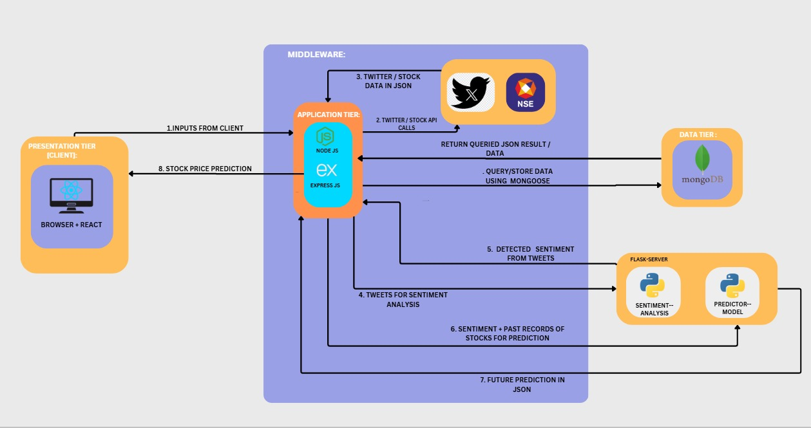
Basic Architecture Diagram

Slide 8
Future Enhancements
Include multilingual tweet analysis for global markets.
Integrate with news sentiment for improved predictions.
Enhance real-time analytics with streaming data pipelines.
Apply to other economic indicators and industries.

Slide 9
THANK YOU

